Slide 1

Types of Abuse

Slide 2
460,000
Sexual assaults each year in Canada
997/1000
Of abusers don’t see jail
Types of Abuse
Mental
Psychologica l
Physica l
Emo tiona l
Sexua l
Verba l
Most domestic violence crimes do not get reported
40%
Of wo m e n in relationships exposed to violence
60%
Of children involved witness the violence
40%
Of women in relationships exposed to violence

Slide 3
Sexua l
Psychologica l
Physica l
Types of Abuse
Verba l
Mental
40%
Of wo m e n in relationships exposed to violence
60%
Of children involved witness the violence
Emo tiona l

Slide 4
40%
Of wo m e n in relationships exposed to violence
60%
Of children involved witness the violence

Slide 5
40%
Of wo m e n in relationships exposed to violence
60%
Of children involved witness the violence

Slide 6
40%
Of wo m e n in relationships exposed to violence
60%
Of children involved witness the violence

Slide 7
460,000
Sexual assaults each year in Canada
997/1000
Of abusers don’t see jail
Psychological
Most domestic violence crimes do not get reported

Slide 8
460,000
Sexual assaults each year in Canada
997/1000
Of abusers don’t see jail
Most domestic violence crimes do not get reported
Sexual

Slide 9
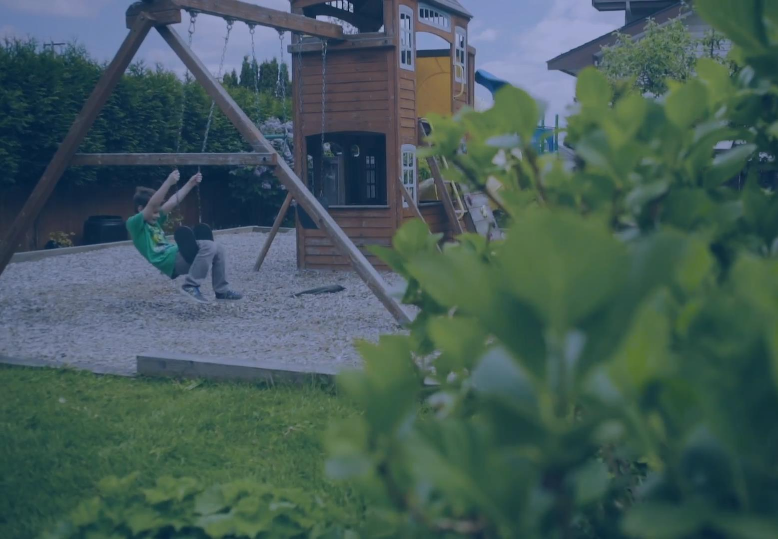

Dixon Transition
Society
shelter, guidance & hope
for women and children fleeing violence
460,000
Sexual assaults each year in Canada
997/1000
Of abusers don’t see jail
Maxwell, Howard, Khoi

Slide 10
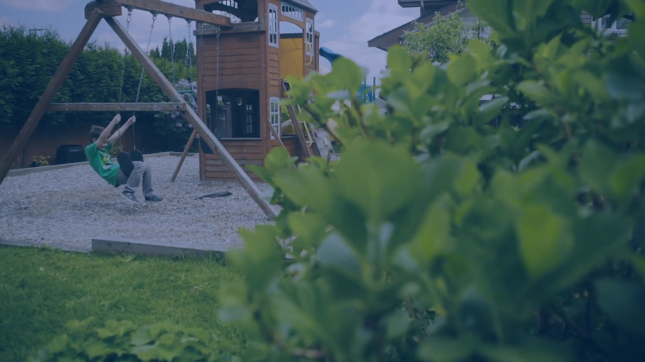
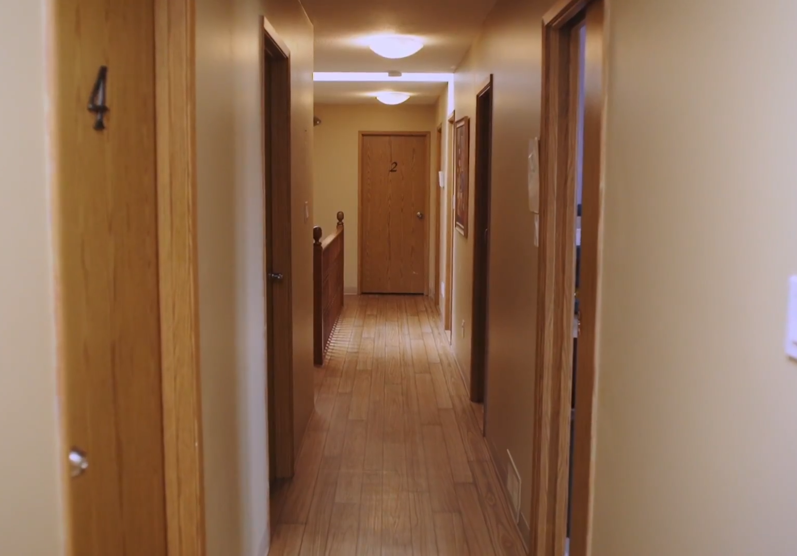
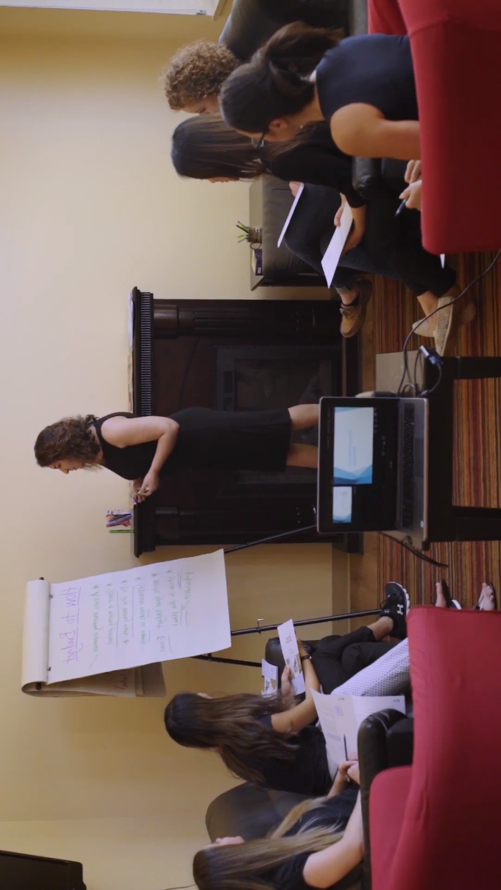


10K
219
Meals Provided
Women and Children
Housed

Slide 11
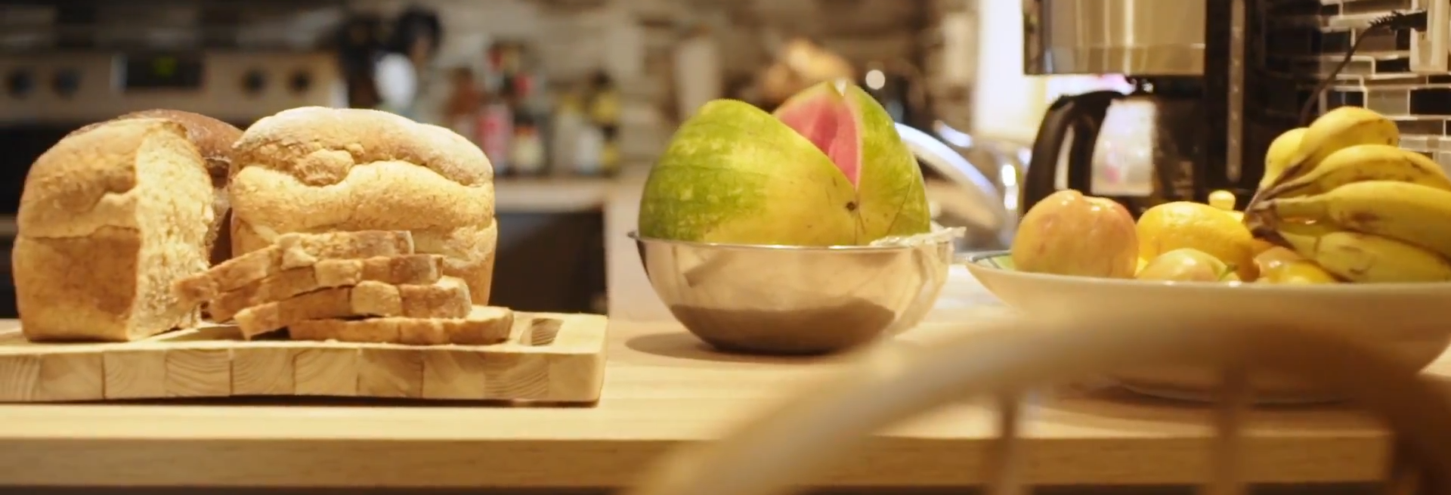
10K
219
Meals Provided
Women and Children
Housed

Slide 12
10K
219
Meals Provided
Women and Children
Housed

Slide 13
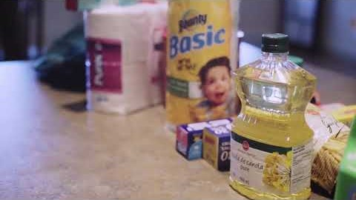

Slide 16
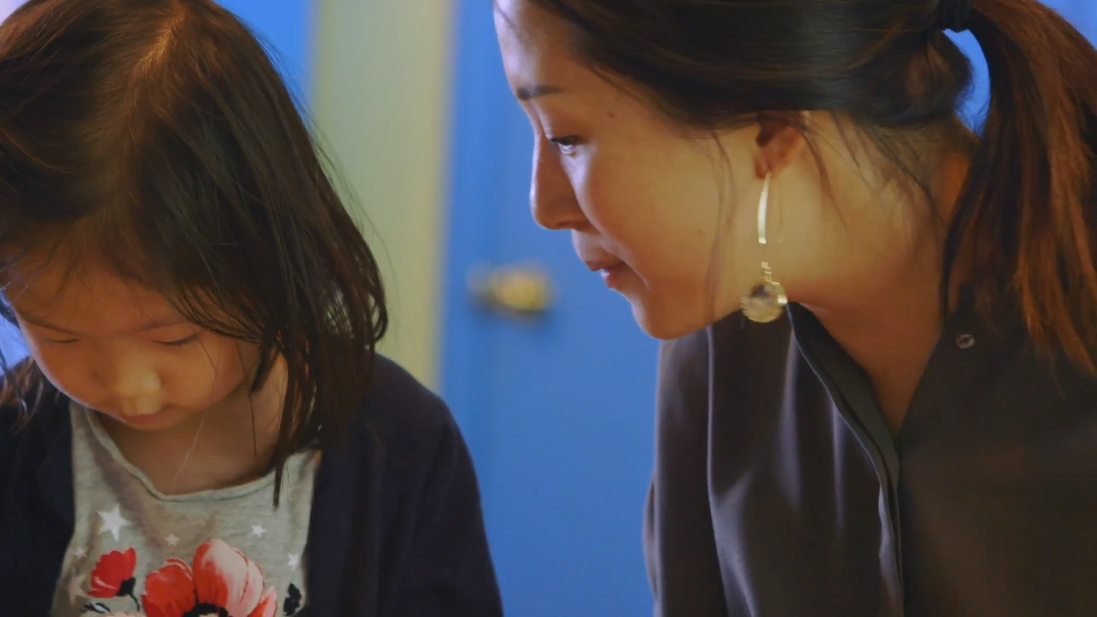
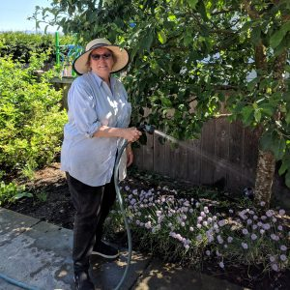
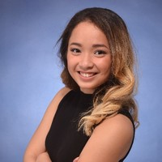
OTHER
SERVICES
Volunteers
Staff
100 volunteer opportunities/year
10 paid staff members

Slide 17
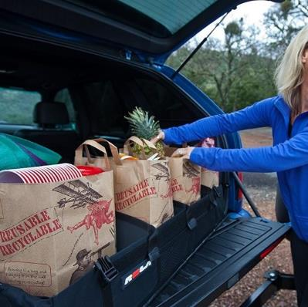

OTHER
SERVICES
Volunteers
Staff
100 volunteer opportunities/year
10 paid staff members
Gardeners
Grocery
Donation Organizing
Help with the garden
at Dixon House
Picking up and delivering groceries to Dixon House
Helping organize shopping trips to Bea’s Boutique

Slide 18
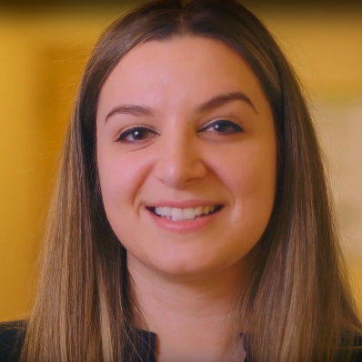
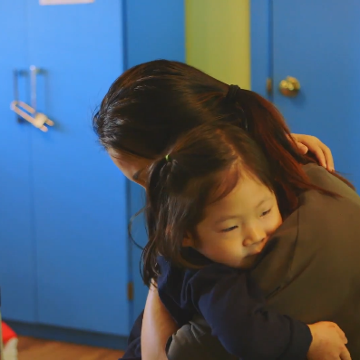
Gardeners
Grocery
Donation Organizing
Volunteers
Staff
Help with the garden
at Dixon House
Picking up and delivering groceries to Dixon House
Helping organize shopping trips to Bea’s Boutique
100 volunteer opportunities/year
10 paid staff members
Administration
Child Support
Housing
Manages paperwork, communications, finances etc.
Helping children adapt to the transition homes
Upkeep of Dixon House, organizes workshops etc.

Slide 19
Gardeners
Grocery
Donation Organizing
Administration
Child Support
Housing
Help with the garden
at Dixon House
Picking up and delivering groceries to Dixon House
Helping organize shopping trips to Bea’s Boutique
Manages paperwork, communications, finances etc.
Helping children adapt to the transition homes
Upkeep of Dixon House, organizes workshops etc.

Slide 20
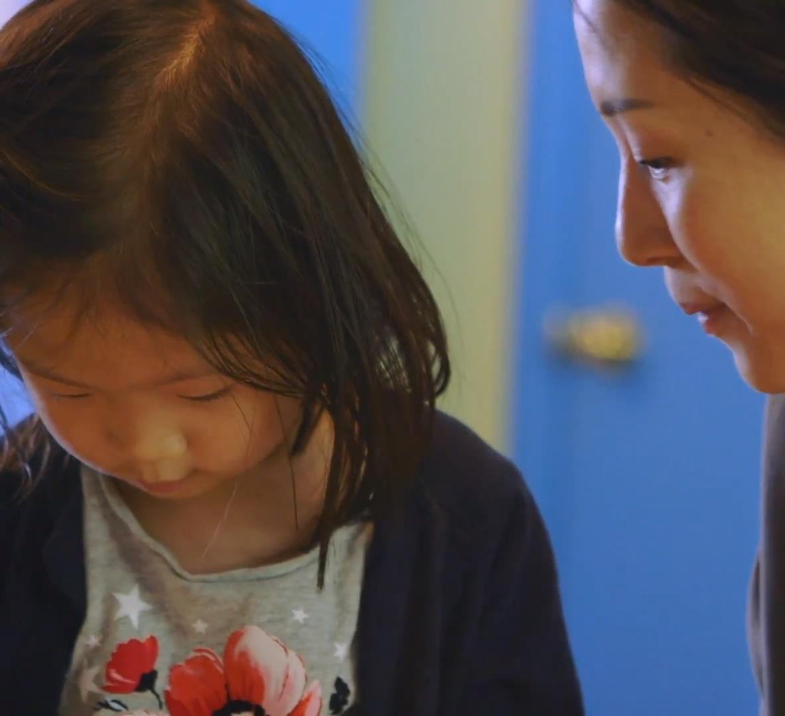
Professional Counselling
Non-judgemental and professional advice for women and families in a safe environment
OTHER
SERVICES
Educa ting the Public
Lessons and semina rs educa ting the pu blic on the problems surrounding a buse and violence
Child Support
Supporting children of mothers at Dixon through their transitional period

Slide 21
Professional Counselling
OTHER
SERVICES
Non-judgemental and professional advice for women and families in a safe environment
Educating the Public
Lessons and semina rs educa ting the pu blic on the problems surrounding a buse and violence

Slide 22
Professional Counselling
Non-judgemental and professional advice for women and families in a safe environment
Educating the Public
Lessons and semina rs educa ting the pu blic on the problems surrounding a buse and violence
Child Support
Supporting children of mothers at Dixon through their transitional period.

Slide 23
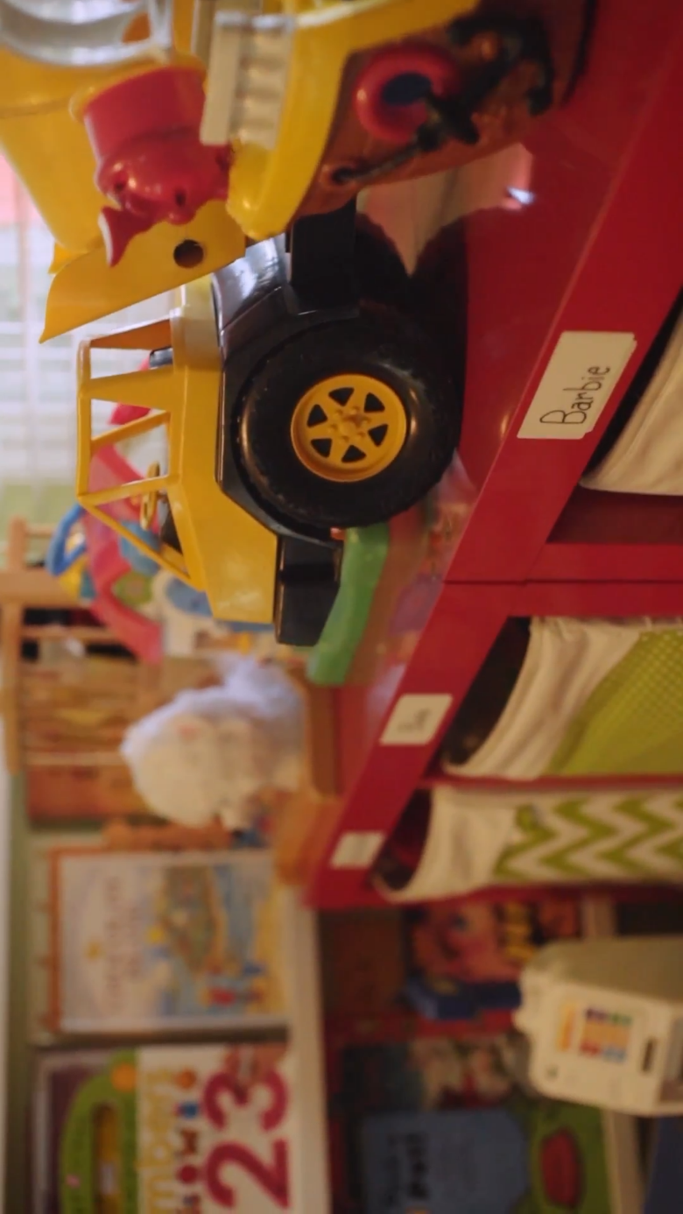
Professional Counselling
Educating the Public
Non-judgemental and professional advice for woman and families in a safe environment
Lessons and semina rs educa ting the pu blic on the problems surrounding a buse and violence
Supporting children of mothers at Dixon through their transitional period.

Slide 24
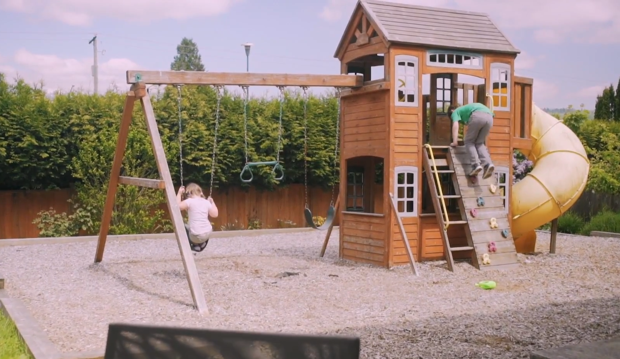
Many seeking shelter have children
Child Support Workers
En roll /transition to school
Help with homework
Activities
Play space
Outdoor playground & garden
Supporting children of mothers at Dixon through their transitional period.

Slide 25
Play space
Outdoor playground & garden

Slide 26


OTHER
SERVICES
Play space
Outdoor playground & garden

Slide 27

FUNDING
OTHER
SERVICES
Many seeking shelter have children
Child Support Workers
En roll /transition to school
Help with homework
Activities

Slide 28

FUNDING
THER
SERVICES
Many seeking shelter have children
Child Support Workers
En roll /transition to school
Help with homework
Activities

Slide 29



FUNDING
OTHER
SERVICES
Many seeking shelter have children
Child Support Workers
En roll /transition to school
Help with homework
Activities

Slide 30
FUNDING
Not enough funding from their biggest fundraisers

Slide 31
FUNDING
$5000
Help them reach their goal to keep the project running
Not enough funding from their biggest fundraisers

Slide 32
FUNDING
$5000
Help reach their goal to keep the project running

